Slide 1

DATA STORAGE FORMATS
in Hadoop

Slide 2
What is HDFS?
Storage system of the Hadoop framework.
Distributed file system that runs on commodity hardware.
Provides access to data across Hadoop clusters
Manages and supports analysis of very large volumes data

Slide 3
Why HDFS?
Zero licensing and support costs
Hadoop clusters can read/write more terabytes of data per second

Slide 4
How data is stored in HDFS
Three ways of storing files in HDFS are
Row oriented
Column oriented
Record Columnar

Slide 5
3 WAYS OF REPRESENTING THIS TABLE ON DISK
CourseId | Title | Instructor | CategoryId
25 | Databases 1 | Jennifer Widom | 10
27 | Databases 2 | Jennifer Widom | 10
28 | Algorithms | Charles Leiserson | 12
30 | Discrete Math | Donald Knuth | 12
35 | Operating Systems | A.Tanenbaum | 40

Slide 6
ROW-ORIENTED
25 | Databases 1 | Jennifer Widom | 10 | □ | 27 | Databases 2 | Jennifer Widom | 10 | □ | 28
Fields of a row are stored contiguously
Quick and easy:
Retrieve an entire row
Insert, update
Drawbacks:
Without indexing, filtering is slower
Entire row has to be read even if we only need a few columns

Slide 7
COLUMN-ORIENTED
25 | 27 | 28 | 30 | 35 | □ | Databases 1
Databases 2 | Algorithms | Discrete M. | Operating S. | □ | J. Widom | J. Widom
C. Leiserson:003 | D. Knuth:004 | A.Tanenbaum:005 | □ | 10 | 10 | 12
12 | 40
Fields of a column are stored contiguously
Benefits:
Each column can serve as an index (fast filtering operations on the whole dataset)
Only selected columns are read
Drawbacks:
Whole-row operations require a lot of disk I/O
Slow and hard inserting and updating
The same row can be stored on different nodes in a distributed environment

Slide 8
RECORD COLUMNAR
CourseId | Title | Instructor | CategoryId
25 | Databases 1 | Jennifer Widom | 10
27 | Databases 2 | Jennifer Widom | 10
28 | Algorithms | Charles Leiserson | 12
30 | Discrete Math | Donald Knuth | 12
35 | Operating Systems | A.Tanenbaum | 40
CourseId | Title | Instructor | CategoryId
25 | Databases 1 | Jennifer Widom | 10
27 | Databases 2 | Jennifer Widom | 10
Row Groups
CourseId | Title | Instructor | CategoryId
28 | Algorithms | Charles Leiserson | 12
30 | Discrete Math | Donald Knuth | 12
35 | Operating Systems | A.Tanenbaum | 40
Horizontal Partitioning

Slide 9
RECORD COLUMNAR
CourseId | Title | Instructor | CategoryId
25 | Databases 1 | Jennifer Widom | 10
27 | Databases 2 | Jennifer Widom | 10
25 | 27 | □ | Databases 1
Databases 2 | □ | Jennifer Widom | Jennifer Widom
□ | 10 | 10
High redundancy in columns Compress them!
Row Groups
CourseId | Title | Instructor | CategoryId
28 | Algorithms | Charles Leiserson | 12
30 | Discrete Math | Donald Knuth | 12
35 | Operating Systems | A.Tanenbaum | 40
28 | 30 | 35 | □
Algorithms | Discrete Math | Operating Sys. | □
C. Leiserson | Donald Knuth | A.Tanenbaum | □
12 | 12 | 40

Slide 10
Some common storage formats for Hadoop
Plain text storage (eg. CSV, TSV files)
Sequence Files.
ORC.
Avro.
Parquet.

Slide 11
SEQUENCEFILE
Header
SYNC
Record
Record
Record
SYNC
Record
Record
Record
SYNC
Record
Record
Record
Split points

Slide 12
SEQUENCEFILE FAILURE BEHAVIOR
Readable to the first failed row
Not recoverable after that point

Slide 13
AVRO
Schema is stored in the header
Supports writing and reading with a different schema (schema evolution)
Supports nested types
Block-based splittable format (SYNC marker)
Optional block compression (Snappy, Deflate)
Excellent failure behavior: only the failed block is lost, reading will continue at the next SYNC marker

Slide 14

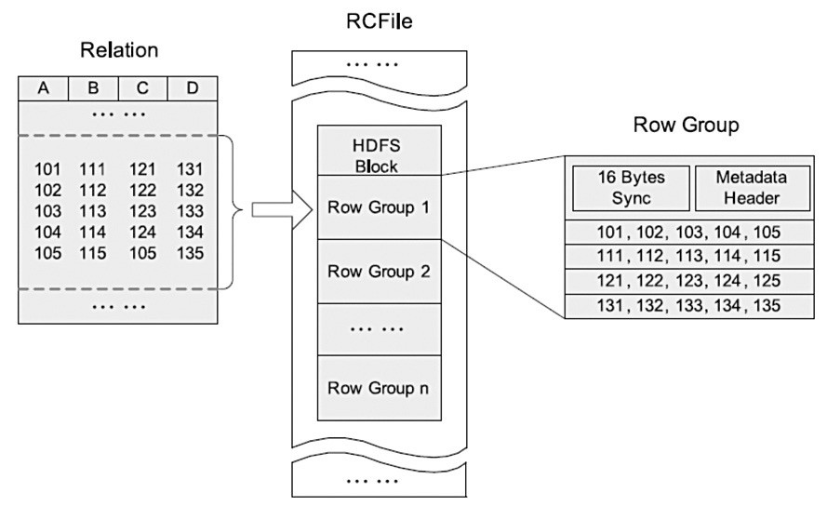
RC FILE
First widespread record columnar format Has much better alternatives today: ORC, Parquet

Slide 15
PARQUET
ORC is designed specifically for Hive
Parquet is a general purpose format
Supports complex nested data structures
Stores full metadata at the end of files

Slide 16
COMPRESSION
Format | Splittability | Write Speed | Read Speed | Compression
gzip | ✖ | ★★ | ★★★ | ★★★
bzip2 | ✔ | ★ | ★ | ★★★
Snappy | ✖ | ★★★ | ★★★ | ★
LZO | ✔ | ★★★ | ★★★ | ★
Each of these are splittable when inside a container format.

Slide 17
THANK YOU

